Slide 1
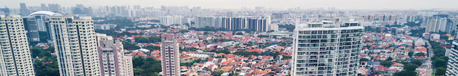



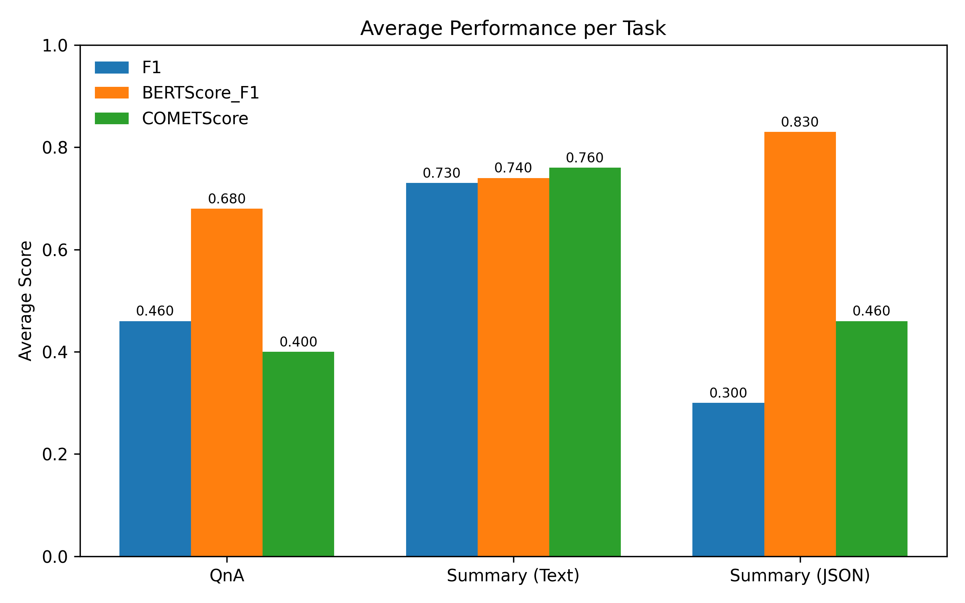
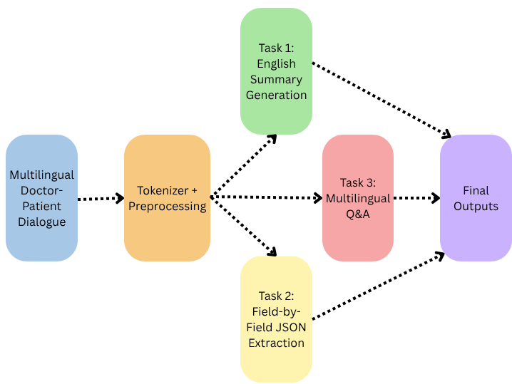

Multilingual Clinical Dialogue Summarization And Information Extraction With
Qwen-1.5B LoRA
Kunwar Zaid, Amit Sangroya, Jyotsana Khatri
TCS Research, New Delhi, India
{kunwar.zaid, amit.sangroya, khatri.jyotsana}@tcs.com
The 14th IJCNLP and 4th AACL Conference
MOTIVATION
Experiments And Evaluation
Clinical conversations are long, noisy, and multilingual, making automated analysis challenging.
Healthcare systems require Concise clinical summaries
Most LLM solution are GPU-intensive
The shared task restricts model size, requiring efficient adaptation under limited compute.
Goal: Build an efficient, multilingual system under constrained compute
Role-based System-User prompts for each task
  Summarization
  Structured extraction
  Multilingual Q&A
Explicit output constraints
  Fixed length summaries
  “N/A” for missing fields
  Language-controlled Q&A responses
Why Field-wise Json Extraction?
Single shot JSON generation failed
  Invalid JSON syntax
  Empty or null fields
  Schema inconsistency
Our Solution:
  Reformulate each field as a separate Q&A task
  Post processing merges answers into valid JSON
TASK DESCRIPTION
Given a doctor-patient dialogue in one of 10 languages, generate
  English clinical summary
  Schema-aligned structured information (JSON)
  Multilingual question-answer responses
Languages include:
  English, Hindi, Gujrati, Tamil, Telugu, Marathi, Kannada, Bangla, Assamese
Evaluation Setup
Official NLP-AI4Health 2025 test set
Metrics
  Q&A: Macro F1
  Summarization: Rouge-L, BERTScore-F1
  Structured extraction: Key-Value F1 (KNV)
METHODOLOGY
Result & Observation
English Summarization
  6-10 sentence clinical summary
  Focus on diagnosis, symptoms, investigations, and management.
Field-wise JSON Extraction
  Each schema field queried independently
  Outputs merged into valid JSON
Multilingual Q&A
  Answers generated in the dialogue’s original language
Model & Training
  Base model: Qwen-1.5B-Instruct
Parameter-efficient fine-tuning: LoRA
  Rank r = 8, alpha = 32, dropout = 0.05
Quantization:
  4-bit NF4 (BitsAndBytes)
Training
  Single epoch
  AdamW optimizer with cosine decay
  Gradient checkpointing + mixed precision
  Trained under strict GPU and memory constraints
Q&A: F1 = 0.46
Summarization
  ROUGE-L = 0.178
  BERT-F1 = 0.83
Structured JSON Extraction: KNV F1 = 0.296
Key Observations
High semantic alignment despite low lexical overlap
Strong performance in:
Moderate degradation in low-resource languages
References
Abacha, Asma Ben, et al. "Overview of the MEDIQA-Chat 2023 shared tasks on the summarization & generation of doctor-patient conversations." Proceedings of the 5th Clinical Natural Language Processing Workshop. 2023.
Dettmers, Tim, et al. "Qlora: Efficient finetuning of quantized llms." Advances in neural information processing systems 36 (2023): 10088-10115.
Hu, Edward J., et al. "Lora: Low-rank adaptation of large language models." ICLR 1.2 (2022): 3.
Lin, Chin-Yew. "Rouge: A package for automatic evaluation of summaries." Text summarization branches out. 2004.

